Slide 1
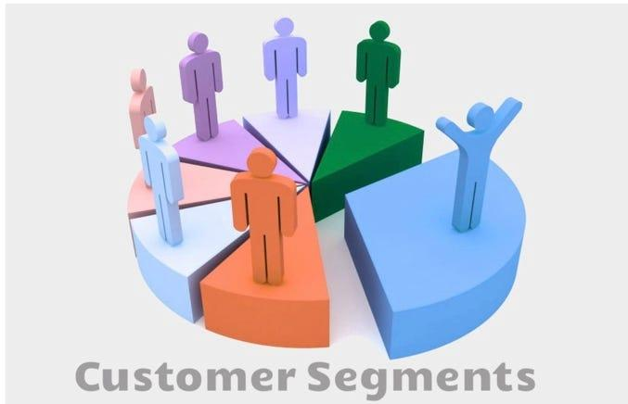
Clustering for
Credit Card Customers
Submitted By :-
Anjali Dembla (ad1704) Daniel Tamayo (dat135) Mariya Ghori (mag494)
Sowmya Yalamanchili (sy744) Tejesh Alaparthi (ta560)
Guided By:-
Dr. Shahrzad Haddadan

Slide 2
Problem Statement Given
Get Rid of Class Labels
Use K - Means Clustering with k = 2,3,4,5 and analyze results
Use Supervised and Unsupervised methods to find the best k and compare results
Use another Clustering algorithm and compare with K-Means

Slide 3
Agenda
Data Preprocessing
Solution to “Get rid of all the class labels”
k-means with various values of k = 2, 3, 4, 5, . . . to find clusters in the data.
Finding the best k, and compare your results
Unsupervised Method: Elbow Plot
Supervised Method: Cross Validation
Hierarchical clustering and compare the results with k-means.
Conclusion

Slide 4
Preprocessing
Fix column names
Check for nulls
Remove unknown values
Remove columns containing Naive Bayes classifier
Transform data using StandardScaler()
Create dummy variables for categorical data

Slide 5
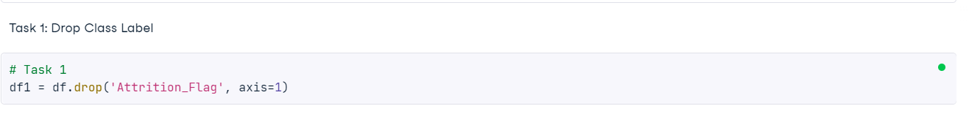
Solution to “Get rid of all the class labels”
Attrition Flag is the Class label.
Below is the code that uses drop function and column name to accomplish the task.

Slide 6
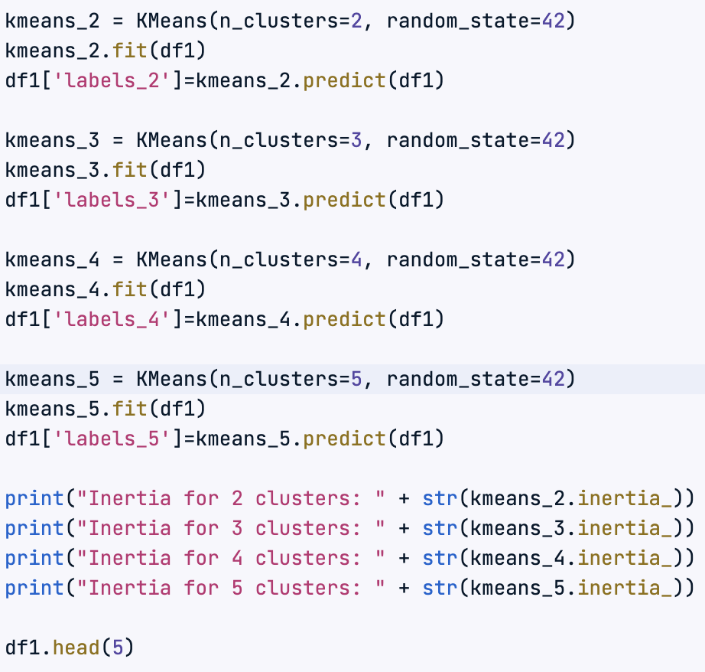
Implementation of K-Means Clustering

Slide 7
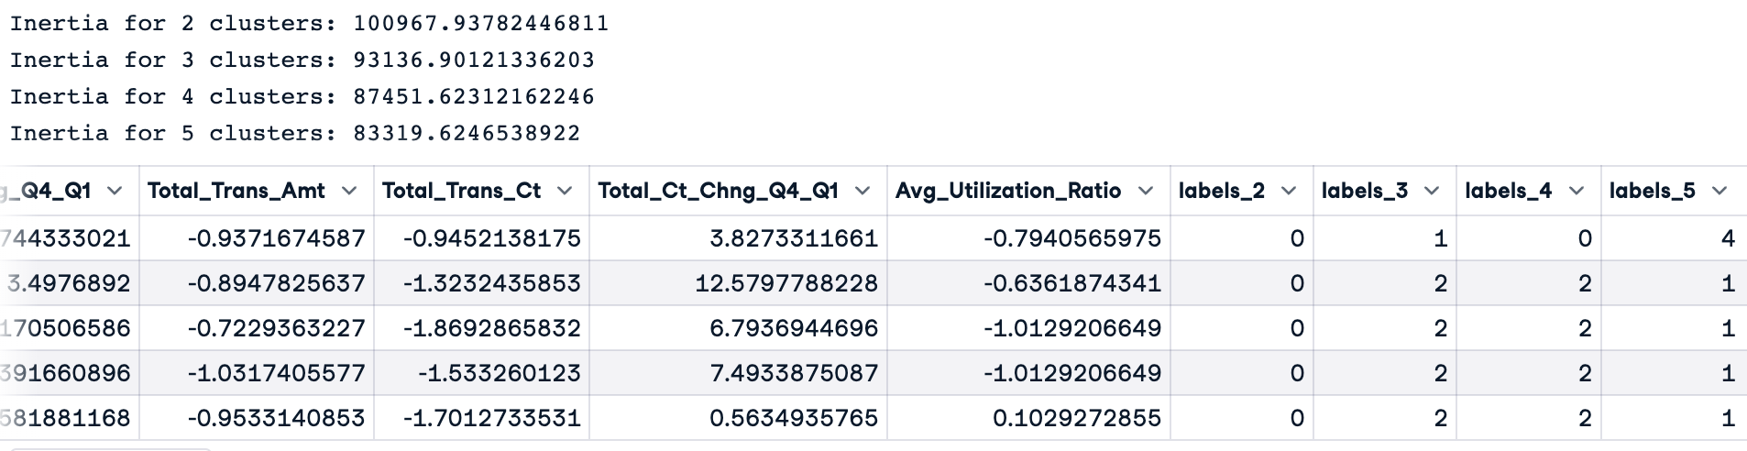
Inertia for Clusters 2-5 and the Corresponding Data Labels

Slide 8
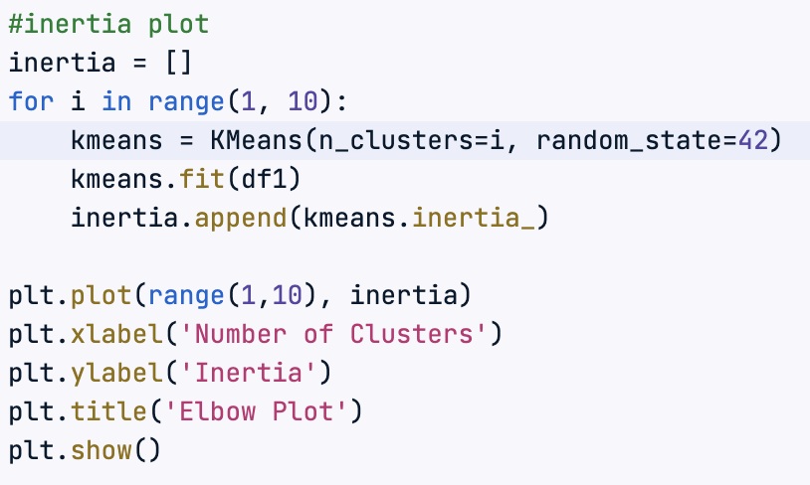
Unsupervised Method to find best k: Elbow Plot

Slide 9
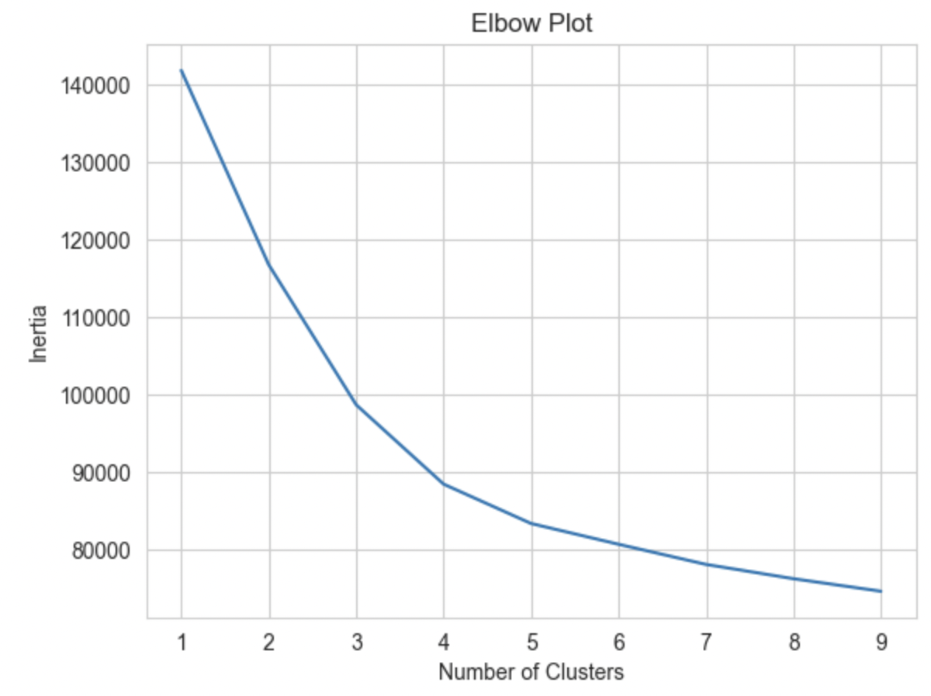
Elbow Plot Graph

Slide 10
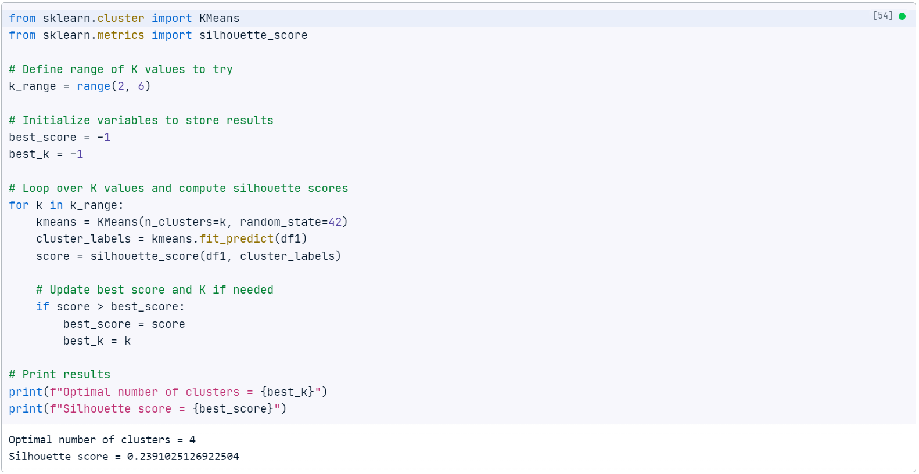
Unsupervised Method: Silhouette Score

Slide 11
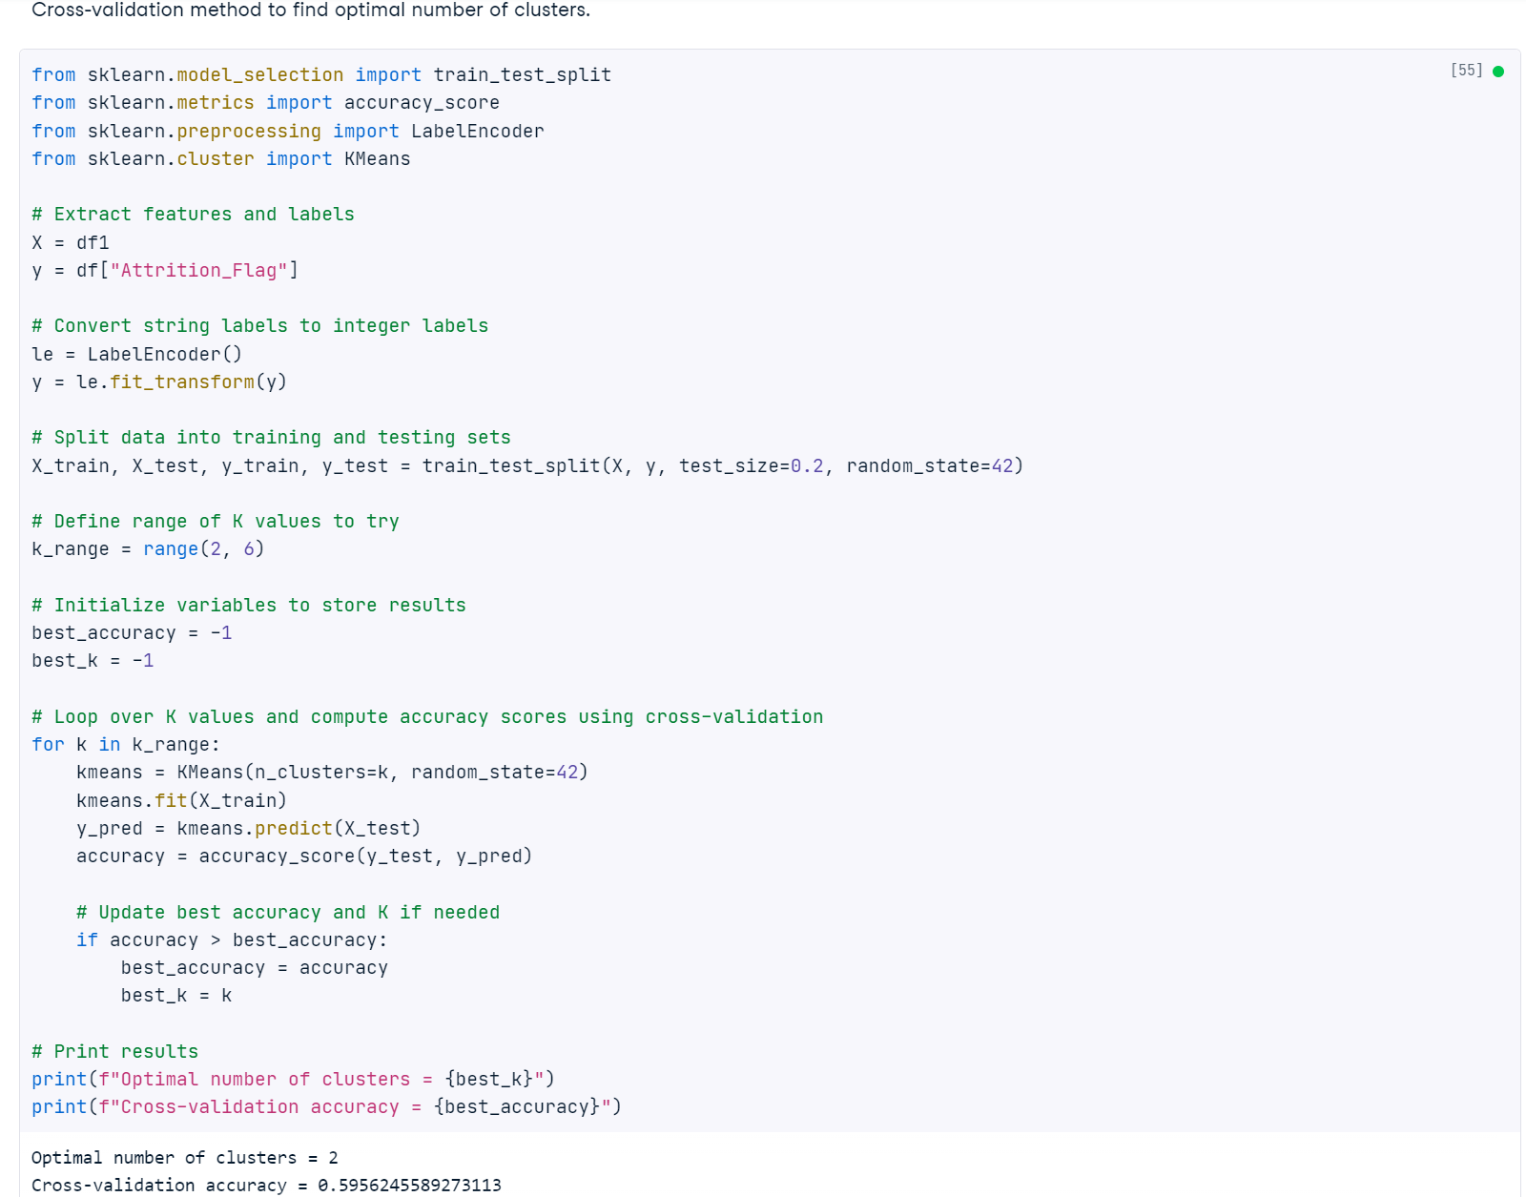
Supervised Method : Cross-validated k-means

Slide 12
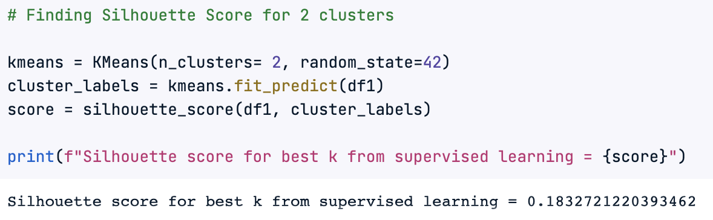
Silhouette Score for 2 Clusters
We recommend using k=4 because it has a higher silhouette score.

Slide 13
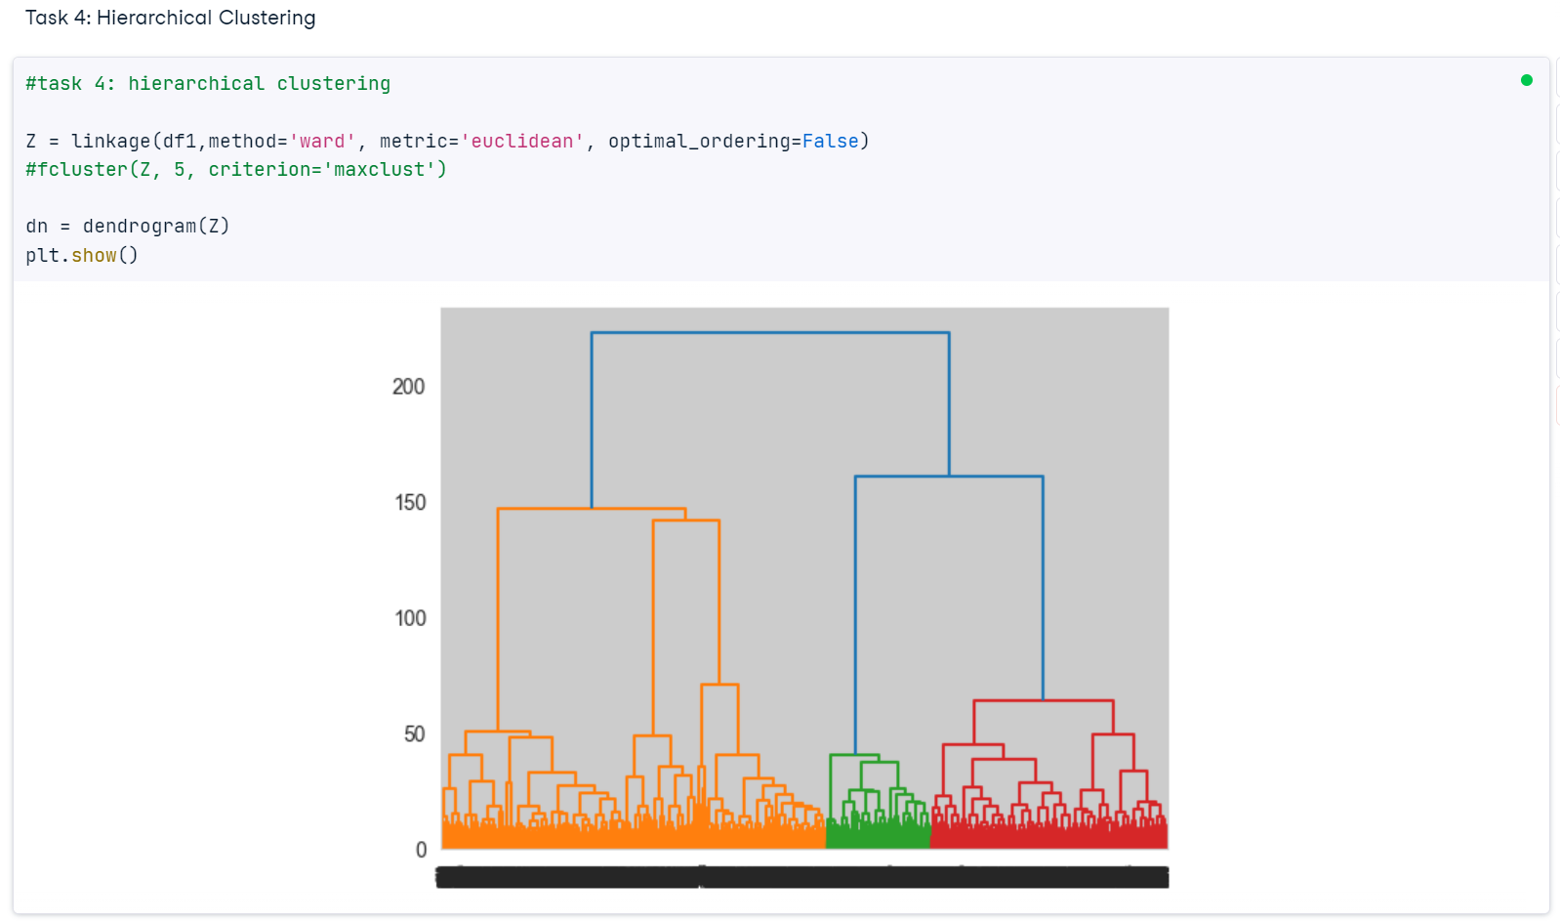
Another approach : Hierarchical Clustering
Hierarchical clustering is a type of clustering algorithm used in unsupervised machine learning, where data points are grouped together based on their similarity. The algorithm works by creating a hierarchy of clusters, where each cluster contains the points that are most similar to each other. The algorithm starts by treating each point as a separate cluster, then it merges the clusters that are closest to each other, and continues this process until all the points belong to a single cluster

Slide 14
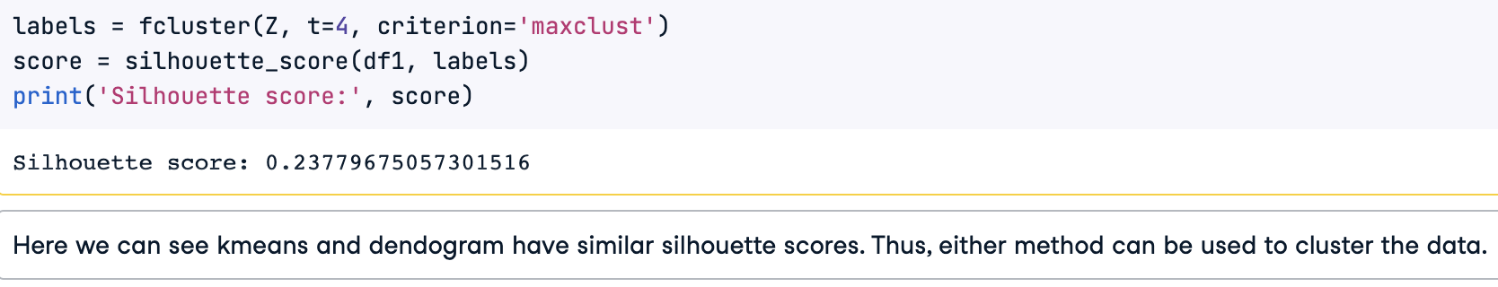
K-means vs Hierarchical Clustering

Slide 15
K-means vs Hierarchical Clustering
K-means Clustering | Hierarchical Clustering
Aims to partition data into a predetermined number of clusters | Aims to create a hierarchy of clusters, often visualized as a dendrogram
Requires specifying the number of clusters in advance | Does not require specifying the number of clusters in advance
Can be computationally faster and more efficient than hierarchical clustering | Can be computationally slower and less efficient than k-means clustering, especially for large datasets
May produce different results depending on the initial starting conditions | Produces more stable results that are less sensitive to initial starting conditions
Assigns each data point to a single cluster | Can assign each data point to multiple clusters at different levels of the hierarchy

Slide 16
CONCLUSION
We implemented k-means with different values of k
Using the elbow plot, the optimal value of k was 4
Using a supervised method, the optimal value of k was 2
We recommend using k=4 because it resulted in a higher silhouette score
We also used Hierarchical Clustering, which gave similar results as k-means
Based on the nature of the data, both k-means and hierarchical clustering result in similar quality clusters. We recommend using k-means clustering due to its computational efficiency.
Hierarchical clustering is useful when the number of clusters is not known in advance or when the data is in the form of a hierarchy, such as in the case of biological taxonomy or organizational structures.

Slide 17


